Slide 1

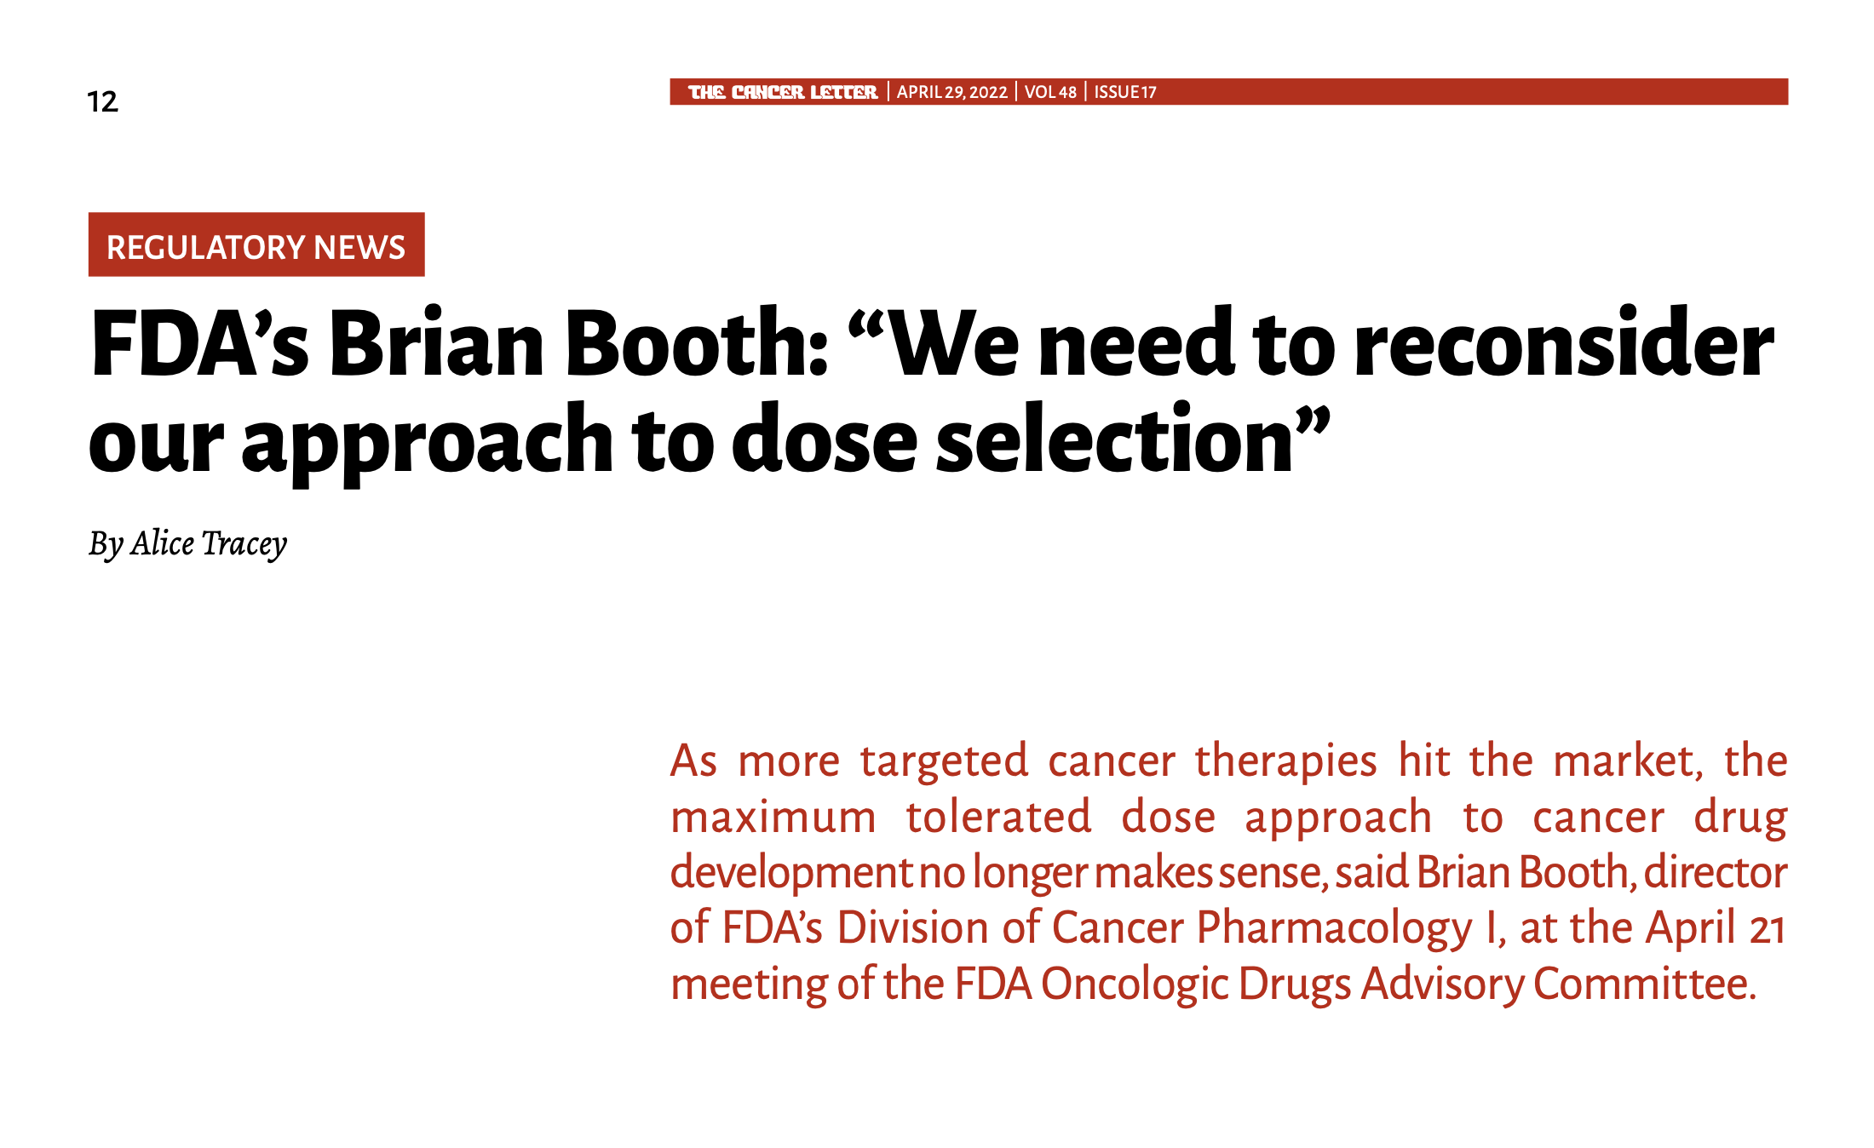
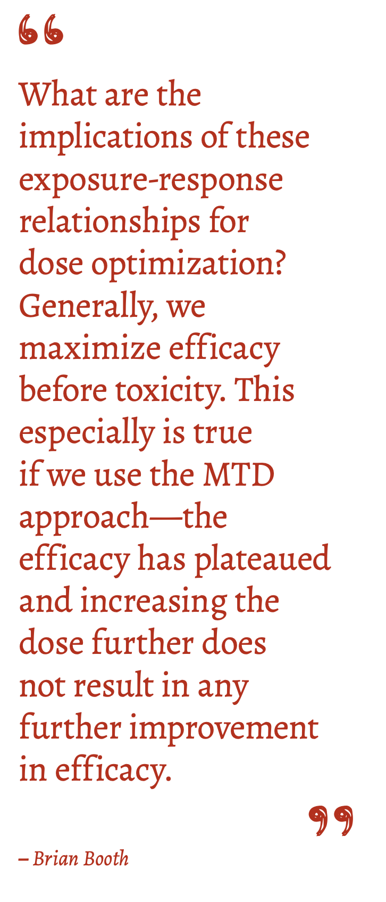
The Cancer Letter – April 2022
Brian Booth: Director of FDA’s Division of Cancer Pharmacology I

Slide 2

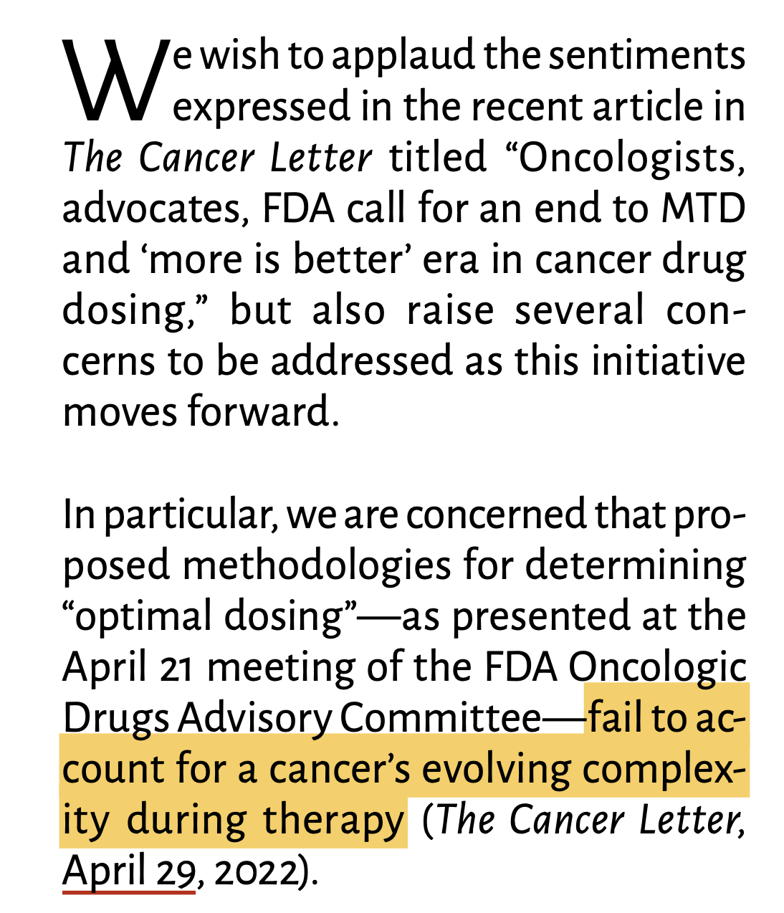
The Cancer Letter – May 2022

Slide 3
Exposure-response curves for targeted therapies
Cytotoxic chemotherapy
Targeted therapies
30
30
20
20
Toxicity / response
Toxicity / response
10
10
5
5
0
0
100 200 300
100 200 300
dose
dose
As many as 50% to 70% of targeted monotherapies have an approved dose less than MTD!
Sachs, Jeffrey R., et al. "Optimal Dosing for Targeted Therapies in Oncology: Drug Development Cases Leading by Example Optimal Dosing for Targeted Therapies in Oncology." Clinical Cancer Research (2016)
Corbaux, Pauline, et al. "Clinical efficacy of the optimal biological dose in early-phase trials of anti-cancer targeted therapies." European Journal of Cancer (2019).
Q. Can we redesign dose selection to probe/infer response convexity/concavity?

Slide 4
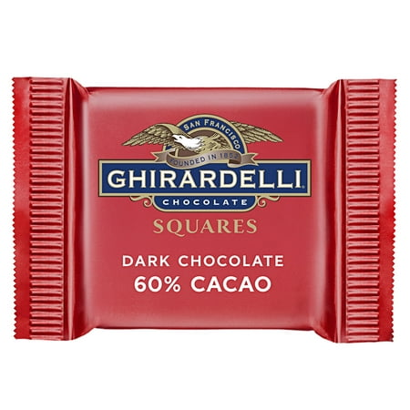
Marginal returns: maximizing benefit
Q. Given 3 chocolates, how often to eat?
Decreasing marginal returns
Scenario 1: eat all the chocolate day 1
1.0
0.75
time
enjoyment
0.50
Scenario 2: eat 1 chocolate per day
0.25
0
1 2 3
time
# chocolates
repeated exposure maximizing enjoyment when marginal returns are decreasing

Slide 5
Marginal returns: maximizing benefit
Q. Given 30 pitches, how often to hit?
Increasing marginal returns
Scenario 1: face the same pitcher a lot on day 1
⚾️ ⚾️ ⚾️
⚾️
30
“in the zone”
⚾️
⚾️
20
time
# of hits
10
⚾️
Scenario 2: face the same pitcher 1 per month
5
“warm-up”
0
⚾️
⚾️
⚾️
10 20 30
time
# of pitches
instantaneous exposure maximizes # hits when marginal returns are increasing

Slide 6


Dose schedules: dose mean ($\overline{x}$) and variance (σ)
Dose Variance
Dose Schedules
dose
dose
variance
is low
x
dose
{$\overline{x}$, $\overline{x}$, $\overline{x}$, $\overline{x}$, …}
Goal:
Develop a mathematical framework for optimizing “second-order” effects
Method:
Use Jensen’s inequality
frequency
time
dose
dose
variance
is high
{$\overline{x}$ + σ, $\overline{x}$ - σ, $\overline{x}$ + σ, …}
2x
dose
0
frequency
time

Slide 7



Dose schedules: dose mean ($\overline{x}$) and variance (σ)
Dose Variance
Dose Schedules
Dose Response
dose
x
dose
{$\overline{x}$, $\overline{x}$, $\overline{x}$, $\overline{x}$, …}
1.0
frequency
time
0.75
% survival
0.50
dose
0.25
{$\overline{x}$ + σ, $\overline{x}$ - σ, $\overline{x}$ + σ, …}
2x
dose
dose
0
$\overline{x}$ - σ $\overline{x}$ $\overline{x}$ + σ
0
frequency
time
“decreasing marginal returns”

Slide 8
Dose schedules: dose mean ($\overline{x}$) and variance (σ)
Dose Variance
Dose Schedules
Dose Response
dose
x
dose
{$\overline{x}$, $\overline{x}$, $\overline{x}$, $\overline{x}$, …}
1.0
frequency
time
0.75
% survival
0.50
dose
0.25
{$\overline{x}$ + σ, $\overline{x}$ - σ, $\overline{x}$ + σ, …}
2x
dose
dose
0
$\overline{x}$ - σ $\overline{x}$ $\overline{x}$ + σ
0
frequency
time
“increasing marginal returns”

Slide 9
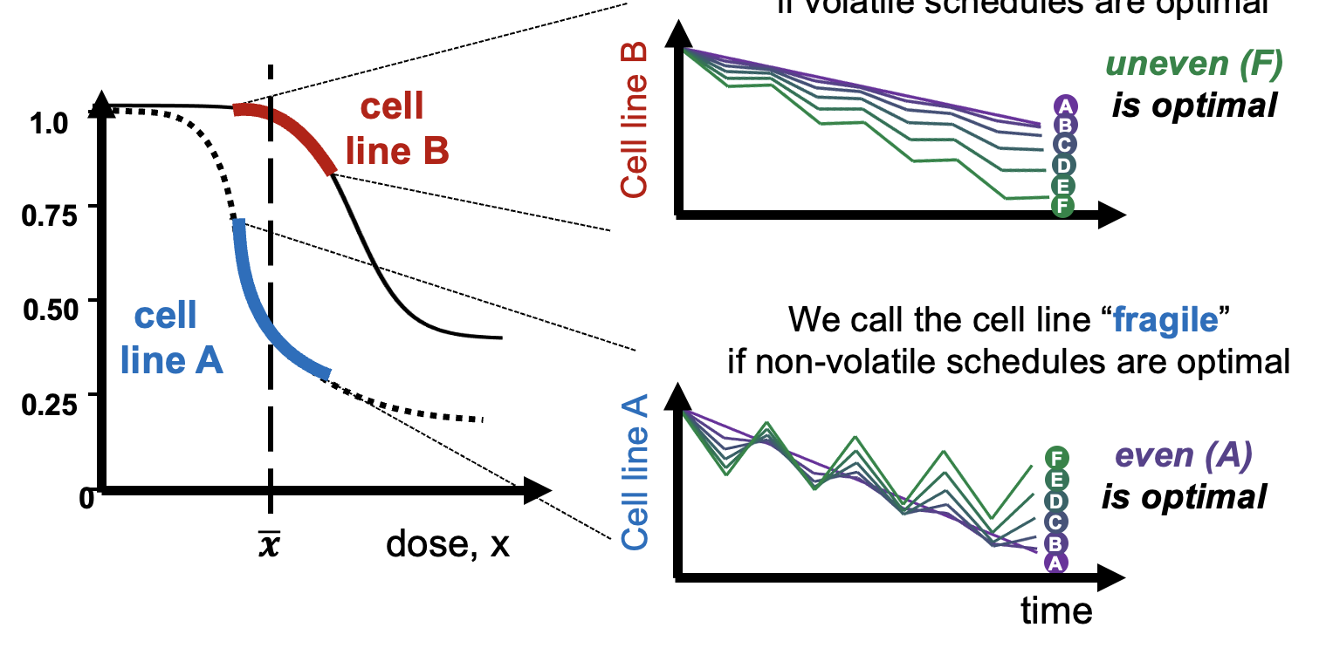
Most cell lines have both convex & concave regions

Slide 10
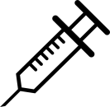
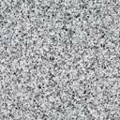
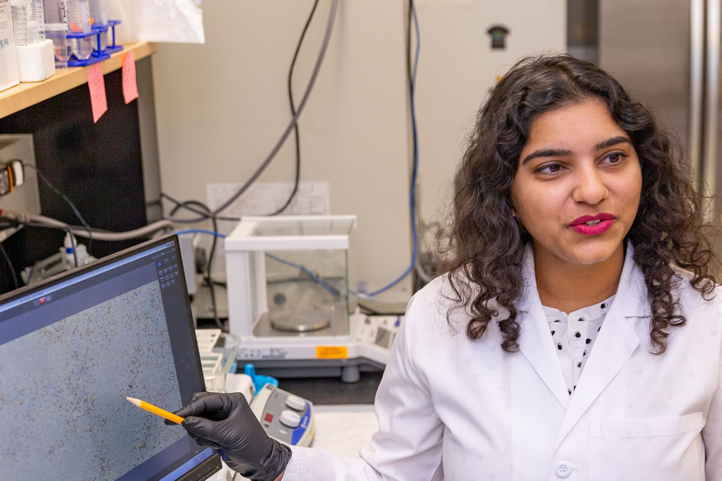
Convexity in Non Small Cell Lung Cancer
Application: Alectinib
blocks the activity of anaplastic lymphoma kinase (ALK)
oral administration
metastatic Non Small Cell Lung Cancer (NSCLC)
High dose: even vs uneven
uneven schedule
dose
uneven
50/0 mpk
time
even
25 mpk
even schedule
Low dose: even vs uneven
Bina Desai
(Andriy Marusyk Lab)
dose
uneven
25/0 mpk
time
even
12.5 mpk

Slide 11
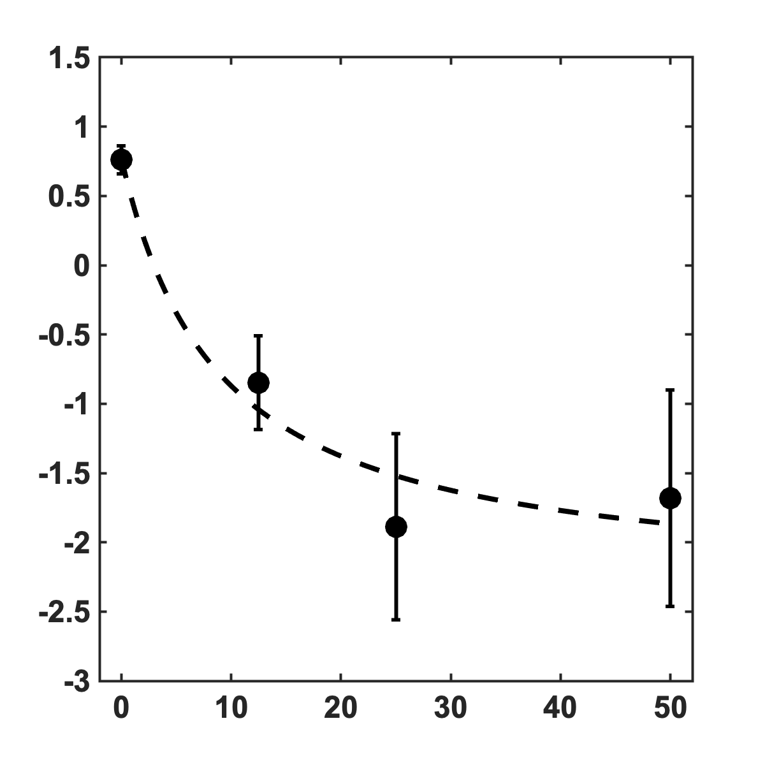
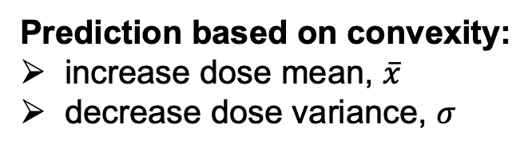
Convexity in Non Small Cell Lung Cancer
Drug-induced proliferation rate
Prediction based on convexity:
increase dose mean, $\overline{x}$
decrease dose variance, $σ$
DIP (doublings/week)
even schedule
dose
time
dose (mpk)

Slide 12
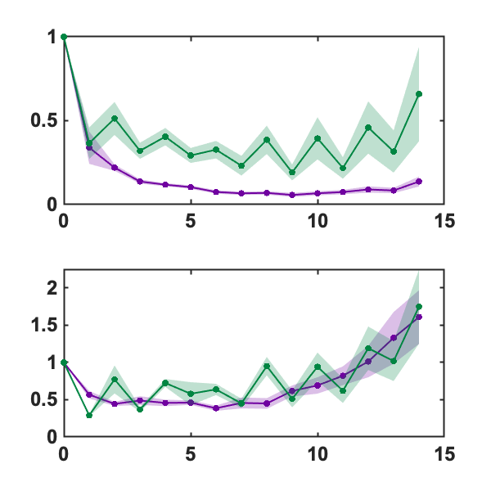
Convexity in Non Small Cell Lung Cancer
High dose: even vs uneven
Normalized tumor volume: v(t)/v₀
uneven
50/0 mpk
tumor vol.
Prediction based on convexity:
increase dose mean, $\overline{x}$
decrease dose variance, $σ$
even
25 mpk
✅
✅
Low dose: even vs uneven
uneven
25/0 mpk
tumor vol.
even
12.5 mpk
*shaded area
indicates standard error
time (weeks)

Slide 13
A simple two cell-state model
“An unbiased metric of antiproliferative drug effect in vitro” Harris, 2016

Slide 14
Drug Induced Proliferation rate: DIP
Drug-induced proliferation rate
DIP (doublings/week)
dose (mpk)

Slide 15
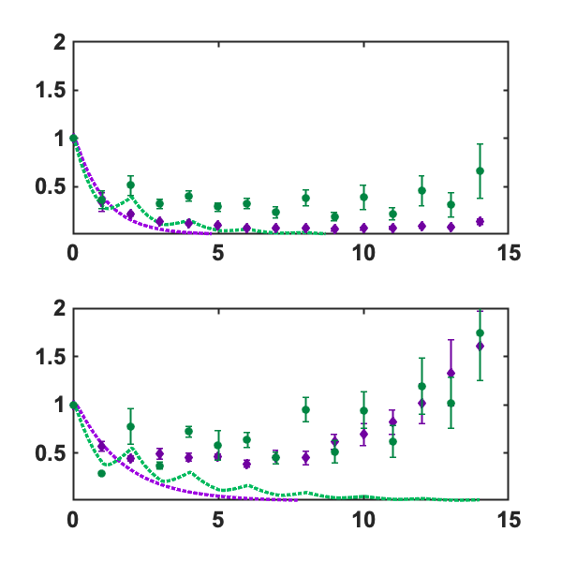
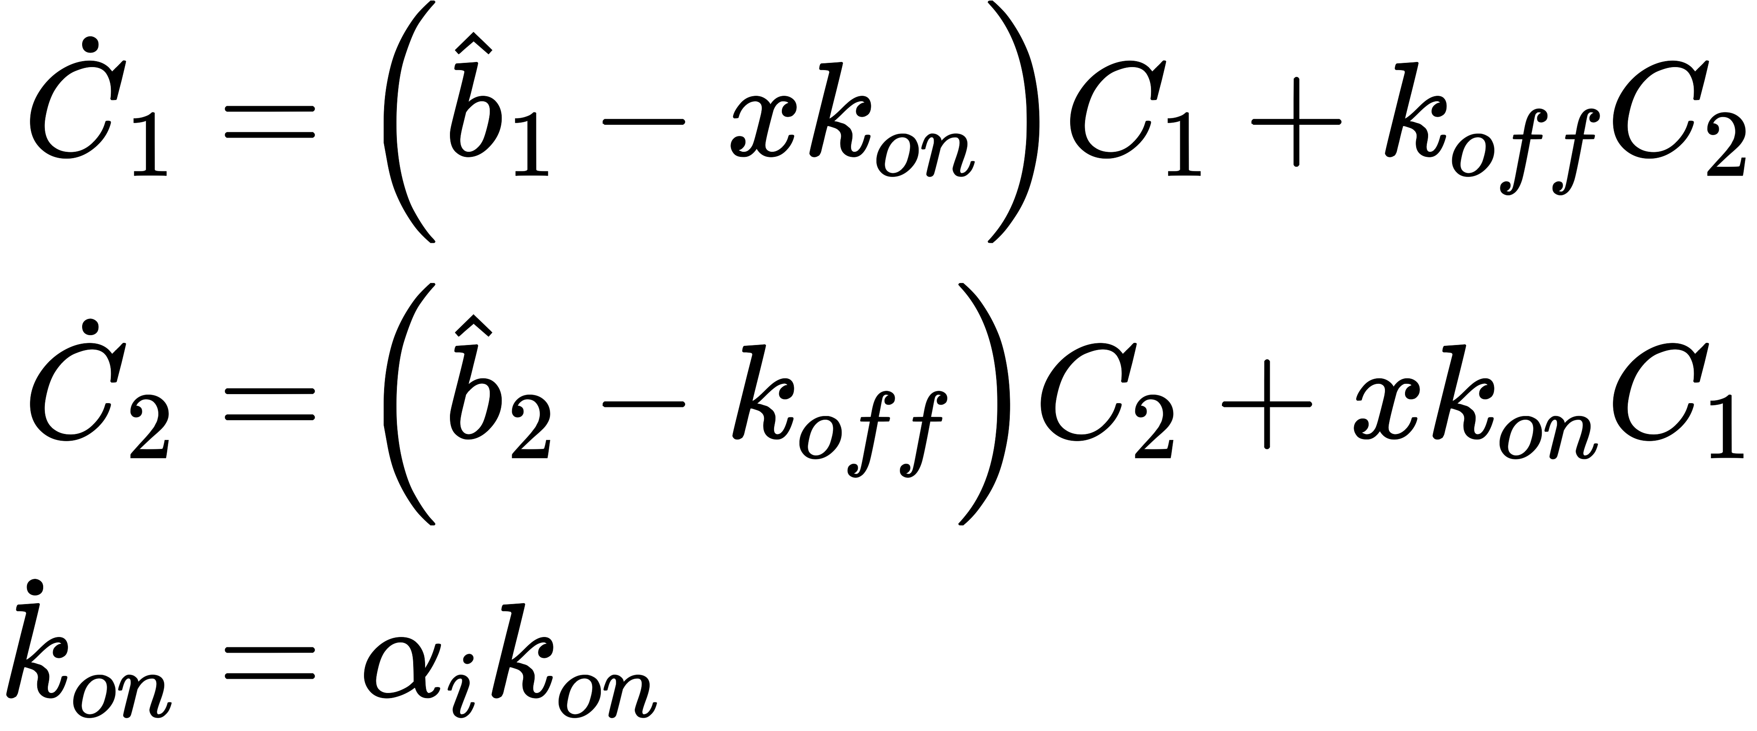
Drug Induced Proliferation rate: DIP
Normalized tumor volume
v(t)/v₀
Two cell state model:
uneven
50/0 mpk
tumor vol.
resistance
occurs gradually
even
25 mpk
uneven
25/0 mpk
tumor vol.
even
12.5 mpk
time (weeks)

Slide 16
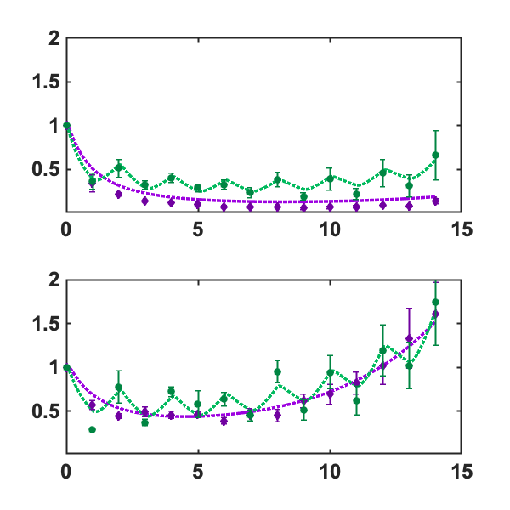
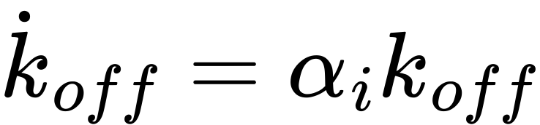

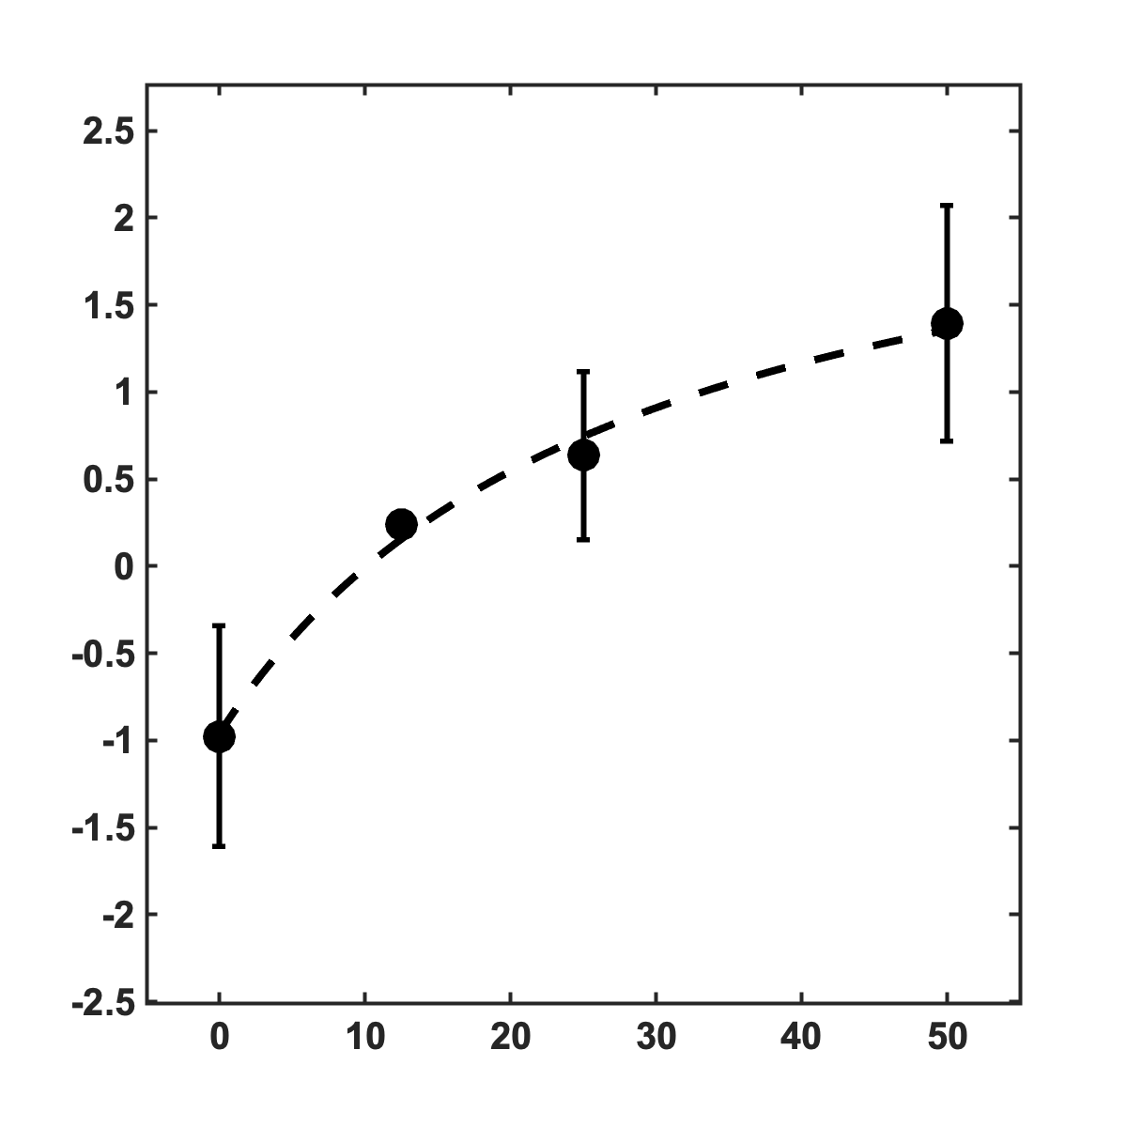
Drug Induced Proliferation rate: DIP
Normalized tumor volume
v(t)/v₀
Two cell state model:
uneven
50/0 mpk
tumor vol.
even
25 mpk
or, equivalently:
uneven
25/0 mpk
tumor vol.
even
12.5 mpk
alpha (1/week)
time (weeks)
dose (mpk)

Slide 17
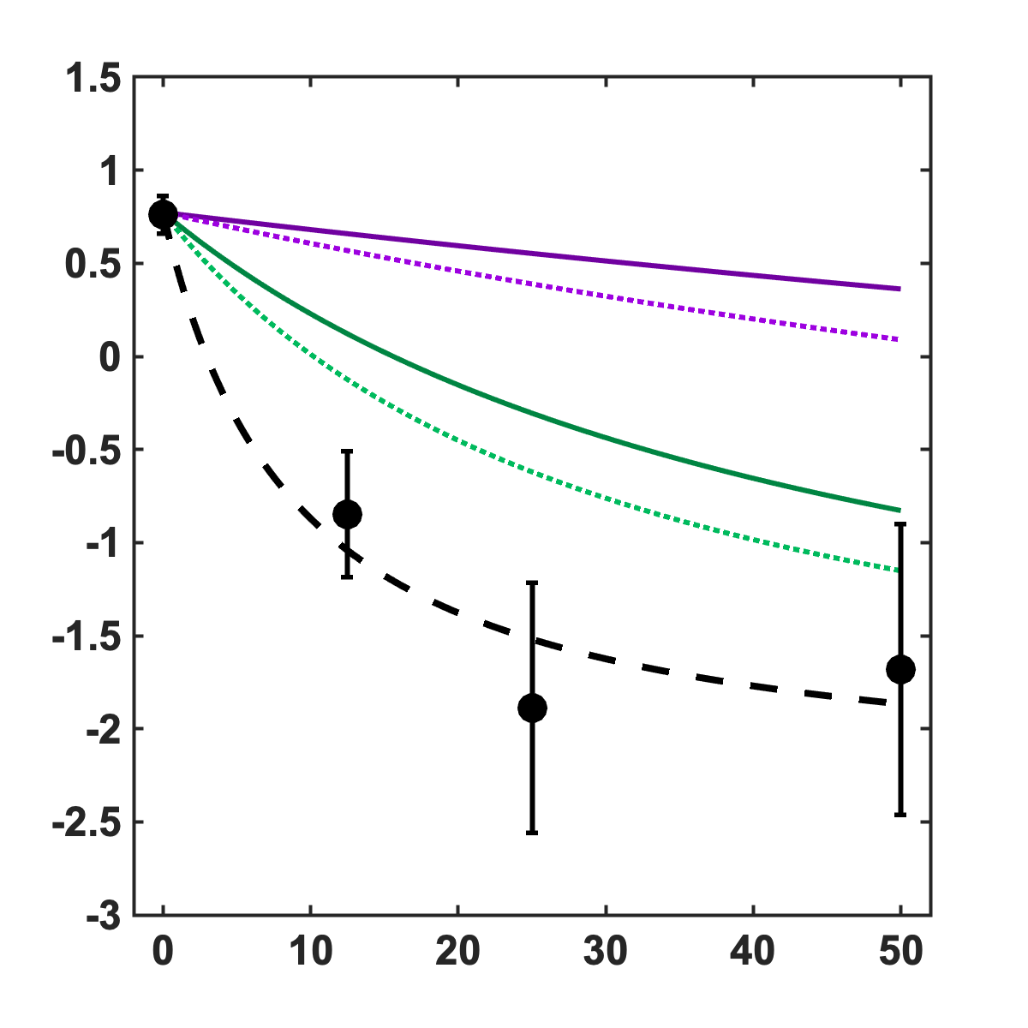
Model-predicted dose response
Dose Response
(model-predicted)
Normalized tumor volume
v(t)/v₀
uneven
50/0 mpk
tumor vol.
even
25 mpk
DIP (doublings/week)
uneven
25/0 mpk
tumor vol.
even
12.5 mpk
time (weeks)
dose (mpk)

Slide 18

Trade-off: convexity and concavity
1. Dose response remains convex
(lower DIP is desired to maximize tumor kill)
2. Treatment Sensitivity function is concave
(higher sensitivity is desired to maximize tumor kill)
gradual resistance
Gradual resistance:
DIP (doublings/week)
alpha (1/week)
re-sensitization
(EC50 ~ resistance)
dose (mpk)
dose (mpk)
… to minimize tumor
… to minimize EC50

Slide 19
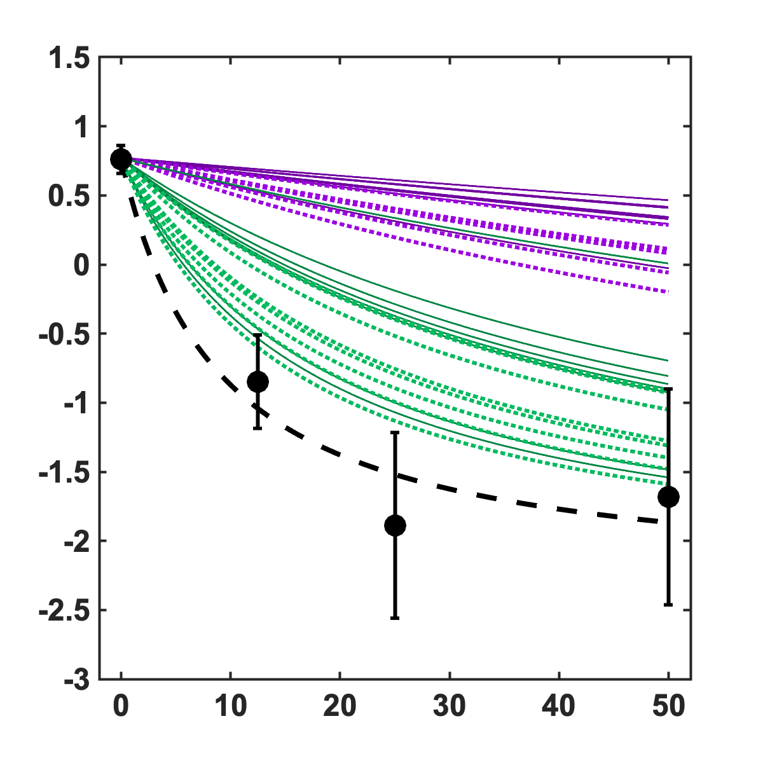
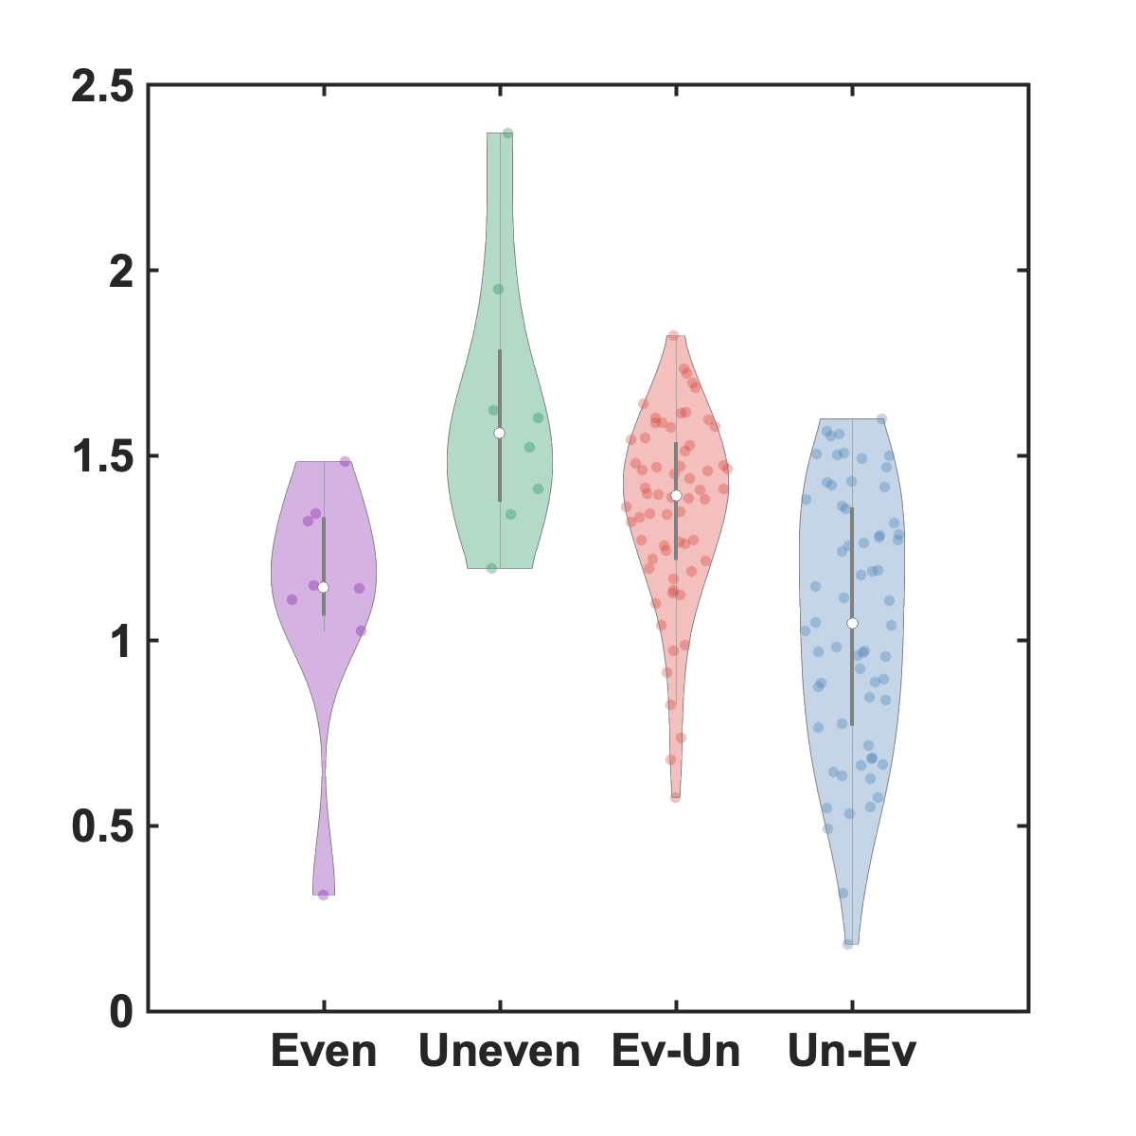
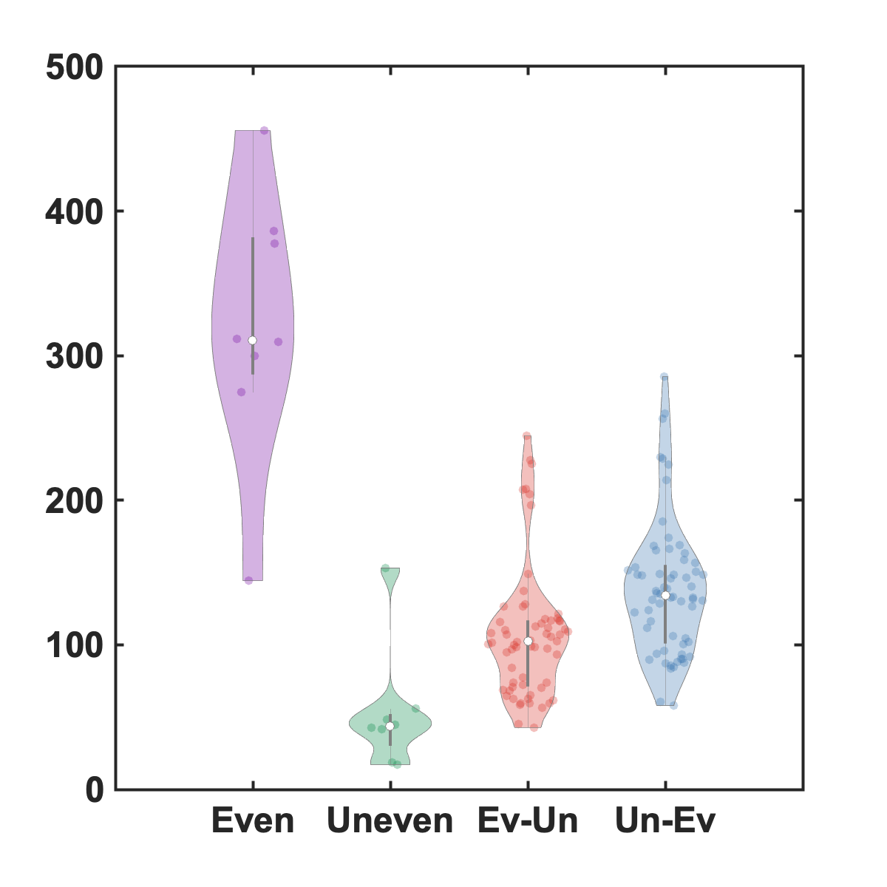
Trade-off: consistent across all mice
1. Dose response remains convex
(lower DIP is desired to maximize tumor kill)
2. Treatment Sensitivity function is concave
(higher sensitivity is desired to maximize tumor kill)
Final tumor size
gradual resistance
DIP (doublings/week)
alpha (1/week)
Final EC₅₀ value
re-sensitization
dose (mpk)
dose (mpk)
… to minimize tumor
… to minimize EC50

Slide 20
Matlab examples: class1.m
%% First, plot an in vivo dose response curve:
% > x_data is values of dose (mg / kg)
% > y_data is values of drug-induced proliferation rate (DIP rate)
figure(1); hold on;
x_data = [0,12.5,25,50];
y_data_mean = [0.7601 -0.8467 -1.8874 -1.6815];
y_data_std = [0.1014 0.3375 0.6722 0.7830];
errorbar(x_data,y_data_mean,y_data_std,'.k','MarkerSize',60,'LineWidth',4);
%% Next, find the best fit dose response function using a Hill function:
H = @(p,x) (1/log(2)) .* (p(3)*p(1) + (x).*p(2)) ./ (p(3)+(x));
Hill_parameters = lsqcurvefit(H,[1,1,1],x_data,y_data_mean); % best fit
%% Finally, plot the best fit on top of the data:
xfit = 0:0.1:50;
DIPFit = H(Hill_parameters,xfit);
plot(xfit,DIPFit,'--k','LineWidth',4);
%% fix the plot's axes / labels:
xlim([-5,55]); xlabel('dose, x (mpk)');
ylim([-3,1]); ylabel('drug-induced prolif. rate (DIP)');
clean();
Hill_parameters
%% save the best-fit parameters for later use:
save('save/Hill_parameters.mat','Hill_parameters');
DIP (doublings/week)
dose (mpk)

Slide 21
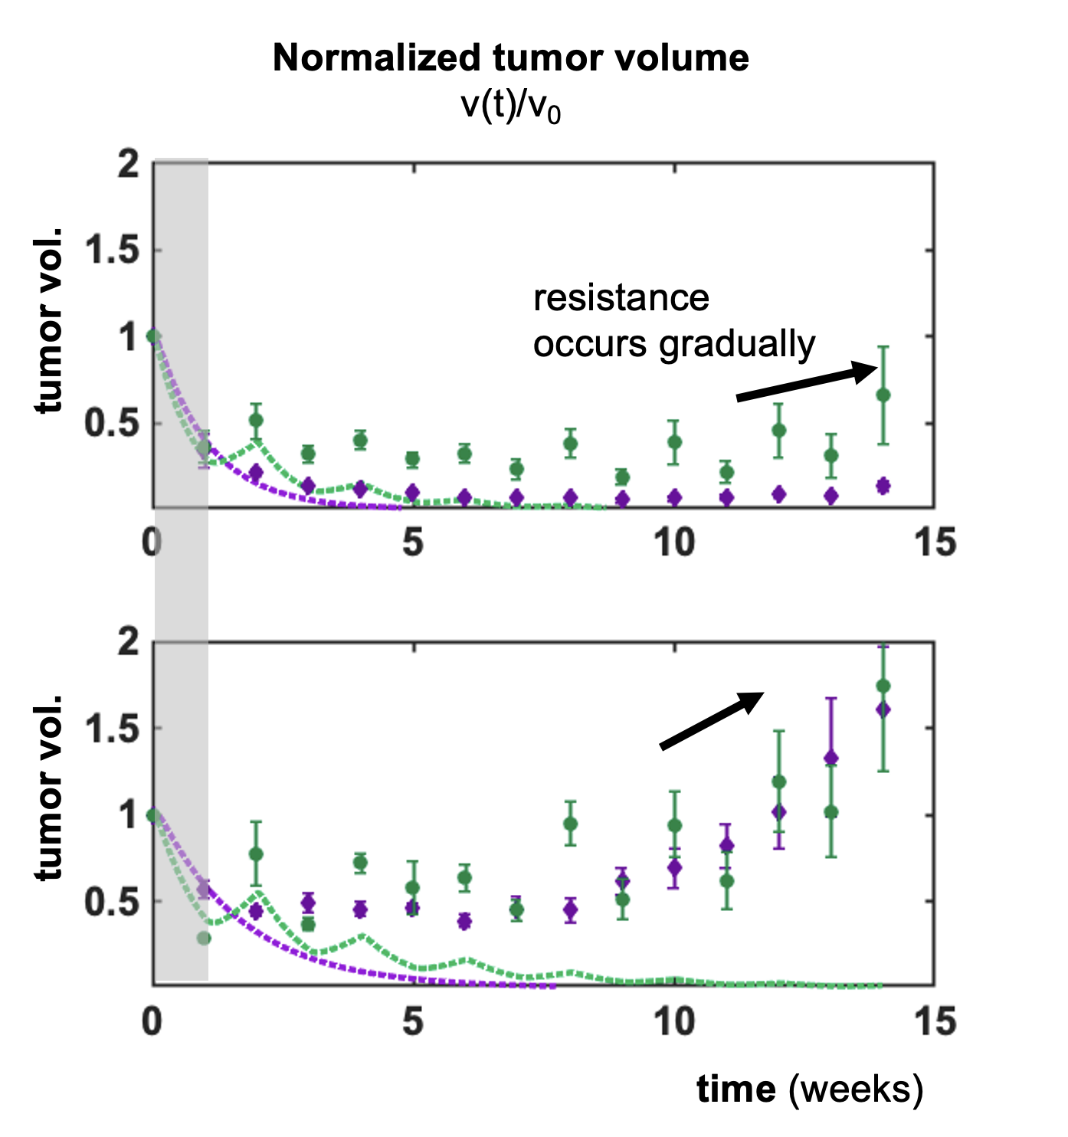
Matlab examples: class2.m
function [time,total_volume] = simulateAndPlotSingleDosingSchedule(t,v,d,color)
% load dose response information:
load("save/Hill_parameters.mat");
b1 = Hill_parameters(1);
b2 = Hill_parameters(2);
koff_kon = Hill_parameters(3);
koff = 5; % set koff to be a constant
kon = koff/koff_kon;
% initial condition:
v0 = [1,0]; % U, A or C1, C2
% tracking vectors etc:
tspan = [0 1]; % 1 week intervals
time=[0];
volume=[v0];
% loop over every week
for i = 1:1:length(d)
dose = d(i);
[tp,y] = ode45(@(t,y) UA_ode(t,y,dose,b1,b2,kon,koff),tspan,v0);
v0 = y(end,:);
tspan = [tp(end),tp(end)+1];
time=[time;tp(end)];
volume = [volume;v0];
end
total_volume = volume(:,1)+volume(:,2);
end
Two cell state model:
Unaffected
Affected

Slide 22
Matlab examples: class3.m
function [volume,t] = simulateAllFourDosingSchedules(parameters,time)
load('data/all-data.mat');
%parameters=[alpha0,alpha12,alpha25,alpha50]
alpha0=parameters(1);
alpha12=parameters(2);
alpha25=parameters(3);
alpha50=parameters(4);
% even-high-dose
[t,v1] = simulateSingleDosingSchedule(t,v(1,:),d(1,:),[],alpha25);
% uneven-high-dose
[t,v2] = simulateSingleDosingSchedule(t,v(2,:),d(2,:),alpha0,alpha50);
% % even-low-dose
[t,v3] = simulateSingleDosingSchedule(t,v(3,:),d(3,:),[],alpha12);
% uneven-low-dose
[t,v4] = simulateSingleDosingSchedule(t,v(4,:),d(4,:),alpha0,alpha25);
% combine the results into a single matrix
t=[t;t;t;t];
volume = [v1;v2;v3;v4];
end
Two cell state model:
Unaffected
Affected
EC50

Slide 23
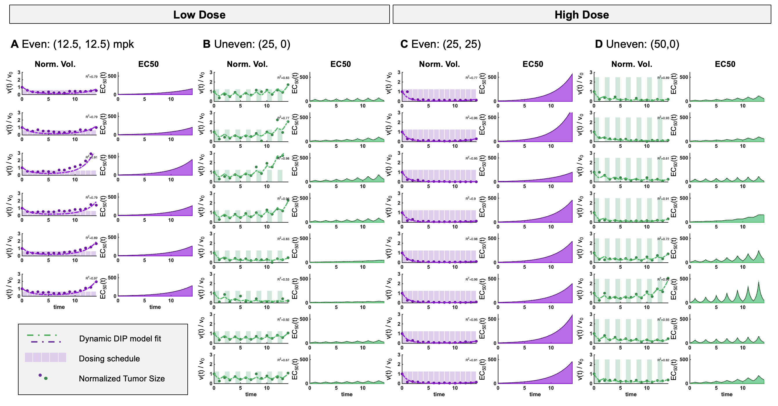
Mouse-specific model predictions

Slide 24
Appendix

